Slide 1
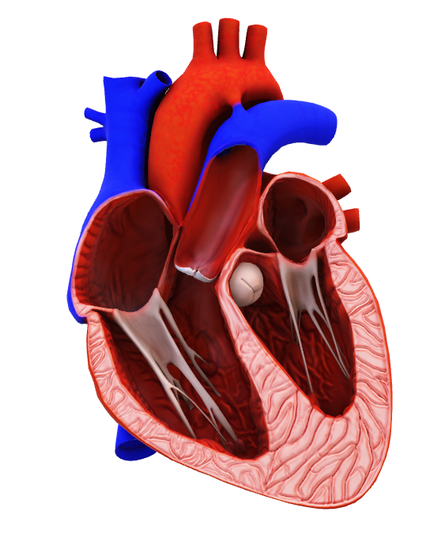
Logistic regression To predict heart disease
Ayesha Ahmad Sumi
Date: 20/06/2025

Slide 2
O
Objectives
World Health Organization has estimated 12 million deaths occur worldwide, every year due to Heart diseases. Half the deaths in the developed countries are due to cardio vascular diseases. This Exploratory Data Analysis intends to pinpoint the most relevant/risk factors of heart disease as well as predict the overall risk using logistic regression.

Slide 3
SOURCE
The dataset is publically available on the Kaggle website, and it is from an ongoing cardiovascular study on residents of the town of Framingham, Massachusetts. The classification goal is to predict whether the patient has 10-year risk of future coronary heart disease (CHD).The dataset provides the patients’ information. It includes over 4,000 records and 15 attributes.

Slide 4
Categorical Feature Distributions

Slide 5
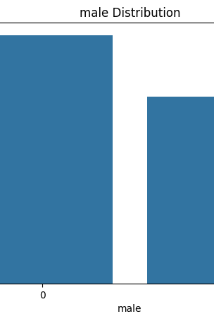
Gender dISTRIBUTION
"This shows the gender distribution in our dataset. A value of 0 indicates male, and 1 indicates female. The data appears fairly balanced, but we can see slightly more males than females. This is important when analyzing gender-based risk for CHD."

Slide 6
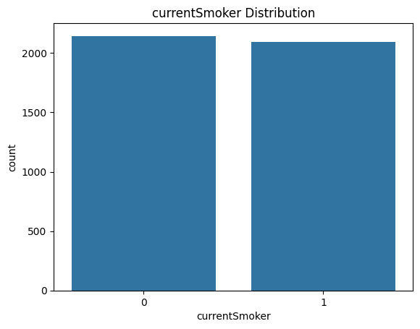
CURRENT SMOKER DISTRIBUTION
"This chart reveals how many individuals are current smokers. We observe a large portion of the population are active smokers, which is a known risk factor for heart disease. This could significantly impact our modeling and risk prediction.

Slide 7
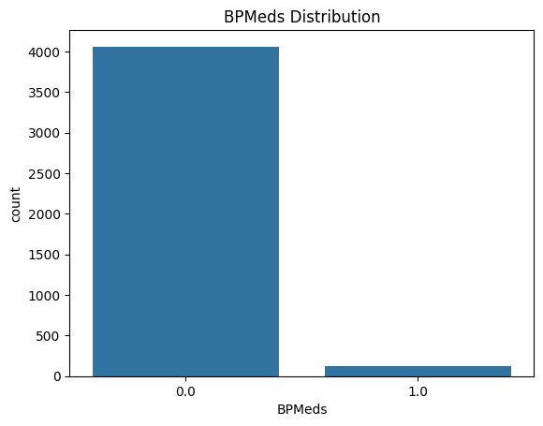
BPMeds DisTRIBUTION
"The majority of individuals are not on blood pressure medication. Those on meds likely have pre-existing hypertension, which ties closely to cardiovascular risk. This imbalance is expected in a general population study."

Slide 8
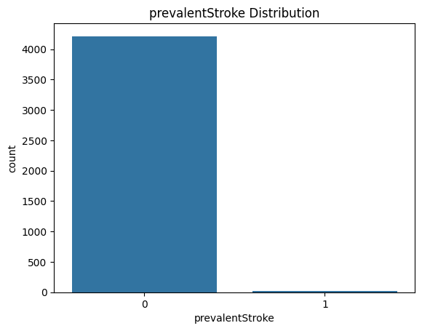
Prevalent stroke distribution
"Very few individuals in the dataset have had a stroke. This low count is typical in community-based health studies, but it's an important indicator because stroke and CHD share common risk pathways."

Slide 9
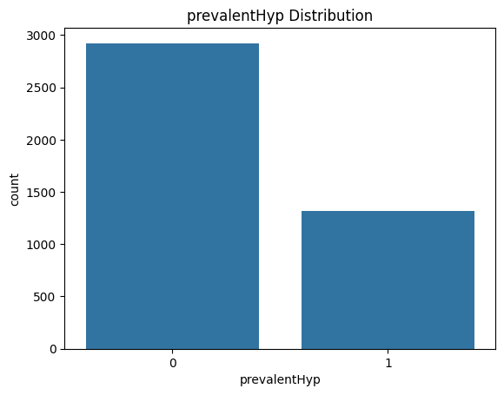
Prevalenthyp distribution
"A significant number of participants have hypertension, which is one of the strongest risk factors for heart disease. This visualization confirms it's a major concern in our population and should be monitored closely in predictive analysis."

Slide 10

Diabetes distribution
"Most individuals are non-diabetic, but the presence of diabetes is still notable. Even though it's a smaller subgroup, diabetes greatly increases heart disease risk and will likely be a key variable in model training."

Slide 11
Numerica value distribution

Slide 12
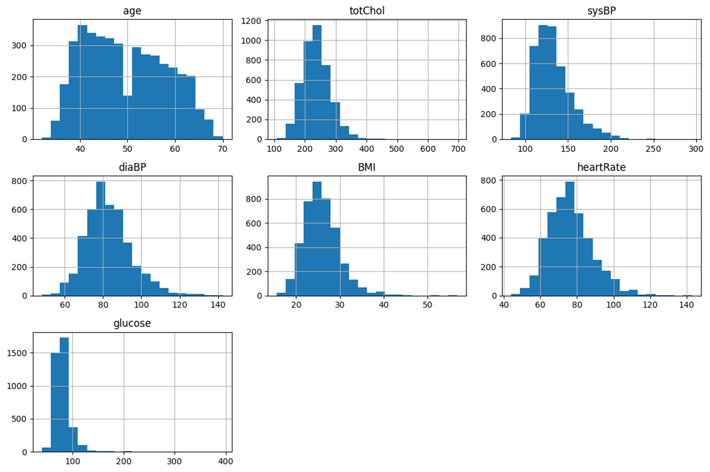
"Age is fairly normally distributed between 30 and 70, with a peak around the 40s. This shows a middle-aged population, which aligns with CHD risk studies.“
"Cholesterol is right-skewed, meaning most people have normal levels, but a few have very high values.“
"Systolic BP shows a wider distribution, with many patients above 120 mmHg — indicating prehypertension or hypertension, a key CHD risk factor.“

Slide 13
"Diastolic BP is more tightly grouped but still shows values that suggest elevated pressure in some patients. The pattern is similar to systolic, just with a lower range.“
"BMI is skewed to the right. Most people are in the overweight category, and a small number are severely obese. This is important since obesity is a CHD risk factor.“
"Heart rate is broadly distributed. Some high values may indicate stress, cardiovascular issues, or measurement noise. Could need outlier filtering.“
“glucose is Very right-skewed, with extreme high values. This suggests either measurement errors, untreated diabetes, or outliers. We’ll consider treating these before modeling."

Slide 14
Feature distribution by CHD outcome

Slide 15
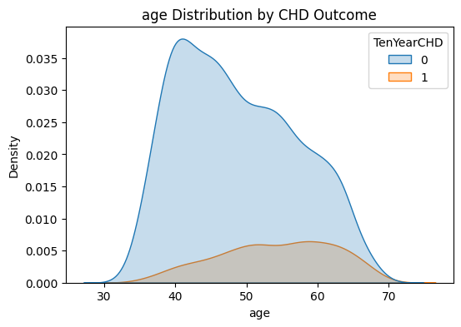
"CHD patients are mostly in the higher age bracket. Age is a strong, intuitive predictor of heart disease risk."

Slide 16
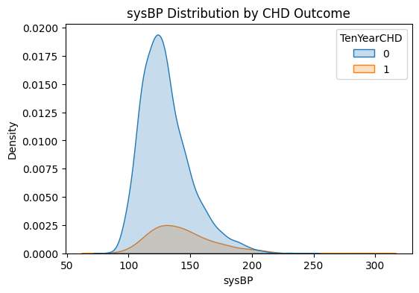
"Participants who developed CHD within 10 years typically had higher systolic blood pressure — confirming its relevance as a clinical risk factor."

Slide 17
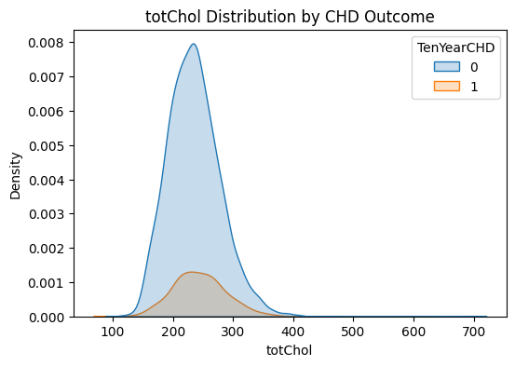
"Cholesterol appears slightly higher in CHD patients but with less separation than other features, suggesting it's a moderate predictor."

Slide 18
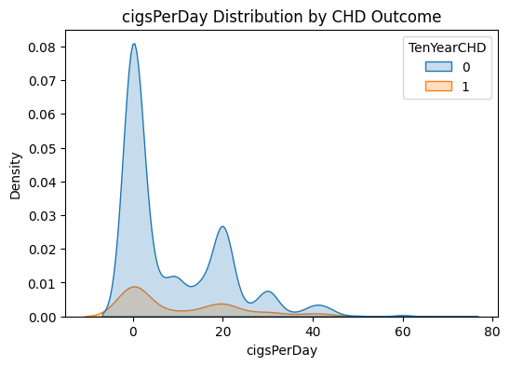
"On average, CHD patients smoke more cigarettes per day. While the overlap is considerable, heavy smoking increases the likelihood of CHD."

Slide 19
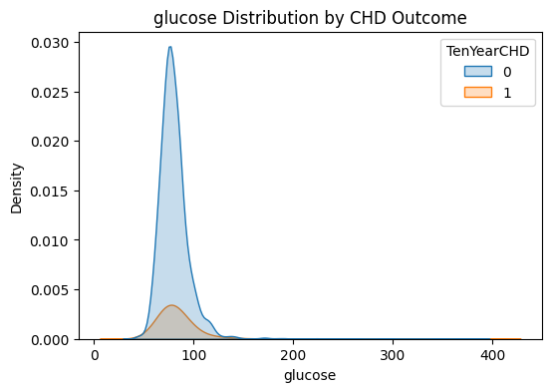
"Glucose levels are more elevated among CHD patients, especially with extreme values, which may represent undiagnosed or uncontrolled diabetes — a known CHD risk factor."

Slide 20
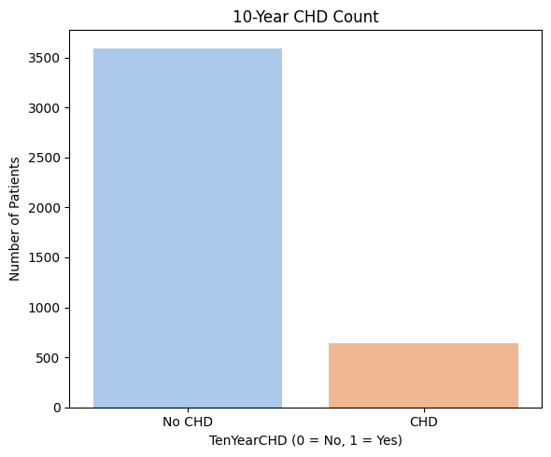
10-year CHD count
"This bar chart shows the number of patients who developed coronary heart disease (CHD) within a 10-year period compared to those who did not."

Slide 21

Feature | CHD Group Trend | Insight
Age | Older | Age is a strong predictor
Systolic BP | Higher | Consistent with hypertension risk
Cholesterol | Slightly higher | Mild predictive value
Cigarettes/Day | Higher in CHD group | Smoking is a risk factor
Glucose | More right-skewed | Suggests link to diabetes/CHD

Slide 22

Model implementation
Define the outliers and clean unnecessary ones
Applying Z-score for feature scaling
Checking empty values as well
Define the dependent and independent variable
Split into train and test 80/20
Use our logistic regression model
Check metrics accuracy score which is about 85%

Slide 23
Confusion metrix
 | Predicted: No CHD (0) | Predicted: CHD (1)
Actual: No CHD (0) | 720 (TN) | 1 (FP)
Actual: CHD (1) | 126 (FN) | 1 (TP)

Slide 24
Evaluating the model
The model is very good at predicting no CHD.
But it fails to detect CHD cases, with only 1 true positive and 126 missed.
This is typical of an imbalanced dataset, where the model favors the majority class (No CHD).
In this dataset we have a distribution of 85% of class 0 and 15% of class 1. So, a dummy model that predicts every case as 0 will have 85% accuracy.
More than that, since this is a heart disease problem our false negatives are way more important than our false positives since a false negative can cost someone’s life.

